Slide 1
CS2 Pressure Test

Slide 2
Objective: Students will inspect, pressure test, determine location of leaks, and determine needed repairs of the coolant system.

Slide 3
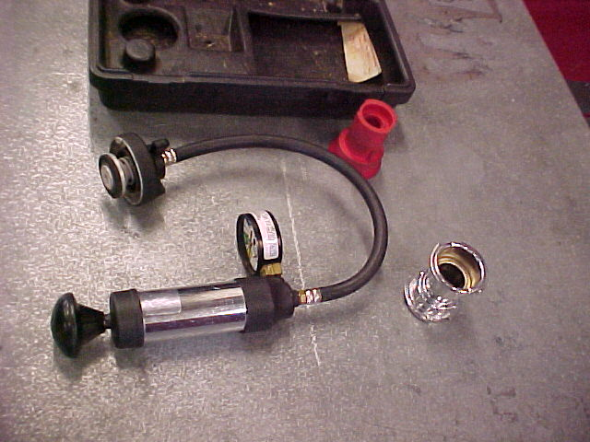
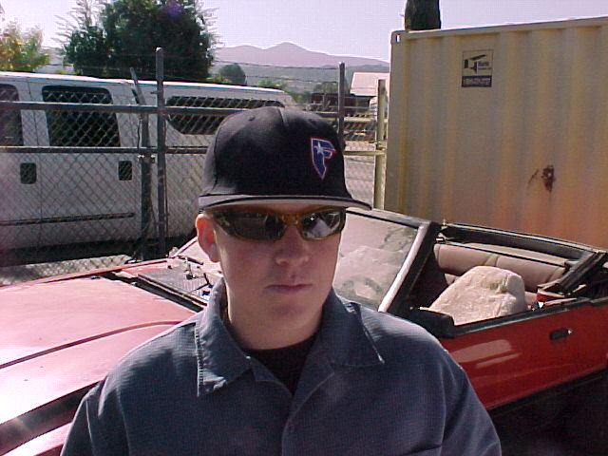
Materials
1. EYE PROTECTION
2. Radiator Pressure tester
3. Approved Coolant
4. Vehicle (see instructor)

Slide 4

WARNING: Do NOT Open While Hot!!!
Look for leakage, wear, weak spots, cracking, fraying, looseness and bulging.
Remove radiator cap and top of cooling system.

Slide 5
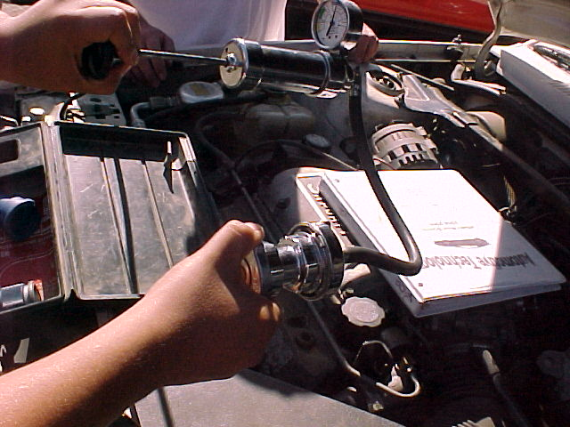
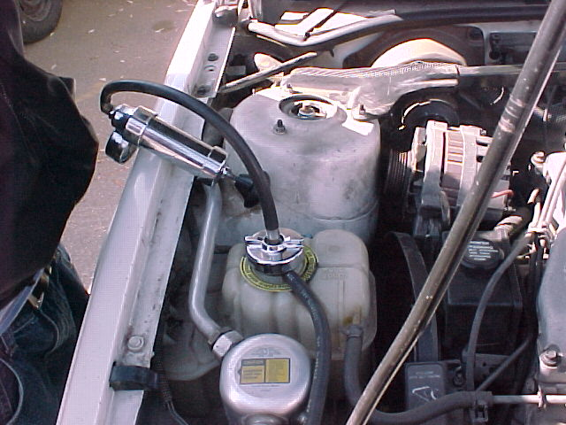
Attach pressure tester according to manufactures specs.
Pump up pressure to PSI rating on radiator cap.

Slide 6
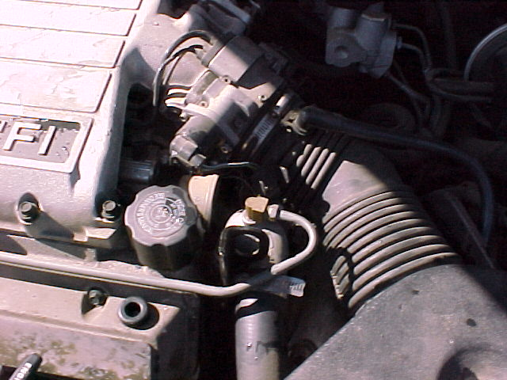
Allow 5 minutes continuing system inspection NOTE any leaks found. NOTE conditions of belts, hoses, and fan. NOTE water pump play.

Slide 7
Eduardo Corrales
Pat Lynch
Kinney Geer
Deaven Konopacky
Mike Gow

